Slide 1



Accenture | Australia & New Zealand
Zero-Touch IAM Security
AI-Powered Complex Process Automation
Built with Google ADK & Agent-to-Agent Protocol
Google Agent Build Challenge
December 15, 2025
Narmada Chowdary Nannaka
Mrunal Tupe
Notes:
Hey Everyone! I’m presenting this under Accenture’s partner submission. What you’ll see reflects Accenture’s engineering capability, and I’ll walk you through the solution and the live demo.
Before we dig into the solution, I want to address what problem this solution solves and why is it worth solving?

Slide 2

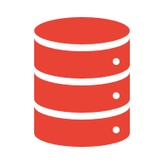






The Real IAM Problem: Current State
Legacy ITSM Ticketing lacks intelligence
IGA Tools are simply static rules and no real-time processing
Manual Interpretation of Policies, Access and Approvers
Access Delays of 2-3 weeks on multiple large programs
No authoritative source of truth
Stale access lasting months
Compliance audit gaps
Multiple manual loops HR-> IT -> Security -> Manager approval chains
Zero-Touch IAM Security automates the entire workflow with AI agents
Notes:
A few months ago, I stepped into the tech and integration lead role for a meter-to-cash program at a major utilities' client. This was my second engagement with them after a year at a mining company in between. The first thing I noticed was simple but telling — my old company email was still active, and the out-of-office message I’d set a year earlier is still working.
But here’s the bigger issue. Basic access for me and my team took three weeks. Not because anyone was slow. The tickets are raised but they the ITSM is just that a ticketing system with no intelligence. The policies are scattered across systems like in SharePoint links, PDFs, and old Confluence pages. No one had a definitive view of what access was needed or who the approver even was.
And this wasn’t new. At the mining company, the same baseline access took a month. Before that, a public sector client took roughly six weeks.
The pattern is obvious across every industry I’ve worked with. The real IAM problem isn’t the tools. It’s the fragmentation, the guesswork and the manual interpretation. And that is exactly the gap this solution closes and what we attempted is automating the interlinked complex business processes using multi-agent orchestration.

Slide 3
Target State - The Solution
1
Request Initiated
Developer requests Editor role
0s
2
Approver Lookup
Query Firestore → alice@example.com
1s
3
Policy Retrieval
RAG → PROD-ACCESS-POLICY-v2
2s
4
Compliance Check
Business hours ✓ (11:30 AM Mon)
3s
5
Email Sent
Gmail API → Approve/Deny buttons
4s
6
Approval Received
JWT validated → Pub/Sub trigger
8s
7
NLU Classification
Gemini 2.5 → APPROVED
10s
8
A2A Execution
Isolated provisioning service
12s
9
Policy Applied
1-hour conditional binding
15s
Notes:
Here’s the after-state of what’s built. Let’s say Sarah, a data engineer is onboarded to a new project, and she needs basic permission to view our instances, a request is initiated. The orchestrator AI agent will fire the lookup agent to identify the related approvers, and associated policies for the requested project scope and permissions. From this, policy context is retrieved instantly using Vertex AI Search. Guardrails like business hours or JIT requirements are enforced before the request ever reaches an approver. Approvers receive a JWT-signed Gmail link that can’t be tampered with or replayed. Gemini 2.5 classifies the response with strict structured output. And a privileged provisioning agent behind the A2A boundary applies a conditional IAM binding with automatic expiry.
All of this completes in under a minute, with full immutable audit lineage written before execution.

Slide 4
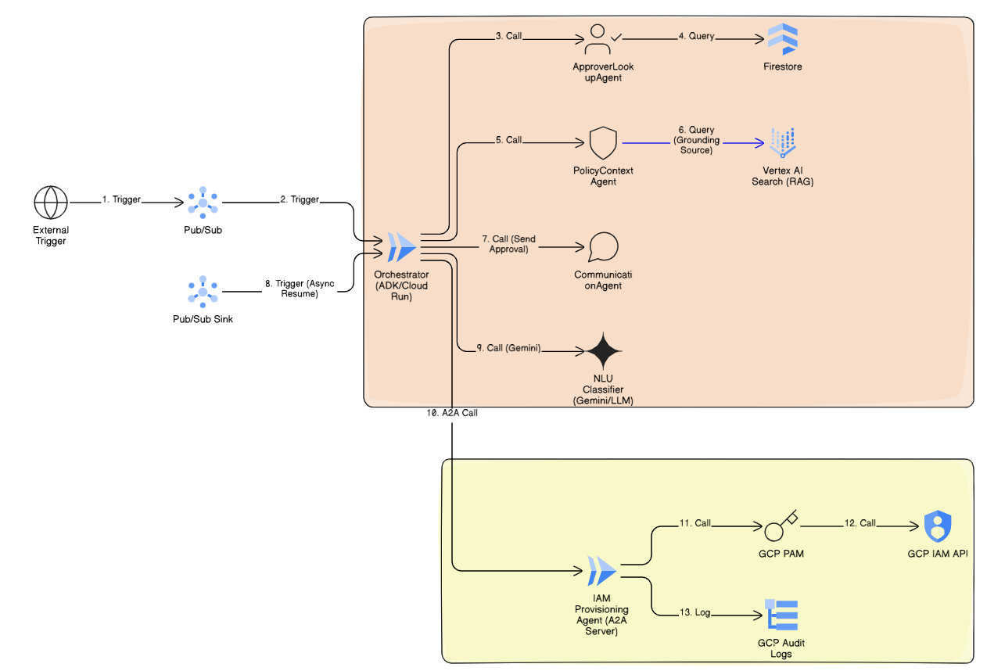
Architecture
Notes:
Let me walk through the architecture at a high level.
On the reasoning side: • the Orchestrator manages workflow and state • the Approver Lookup agent pulls the correct approver from Firestore • the Policy Context agent extracts rules from real policy documents via RAG Vertex AI search • the Communication agent sends the approval request via Gmail • the NLU agent interprets the approval decision using Gemini 2.5 Flash
This entire layer has no IAM privileges.
On the execution side sits the Provisioning Agent. It runs behind the A2A server, validates caller identity with ID tokens, and applies conditional IAM bindings.
Everything is modular, isolated, and production-aligned.

Slide 5
Live Demo
https://iam-orchestrator-service-1056400841359.asia-southeast1.run.app

Slide 6


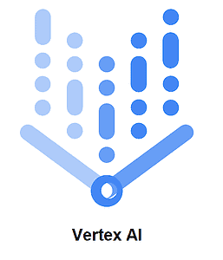
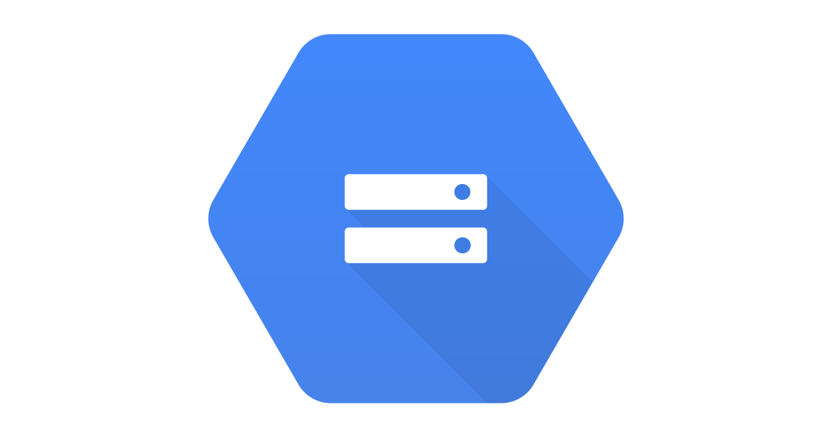
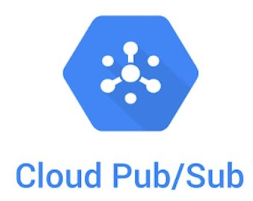





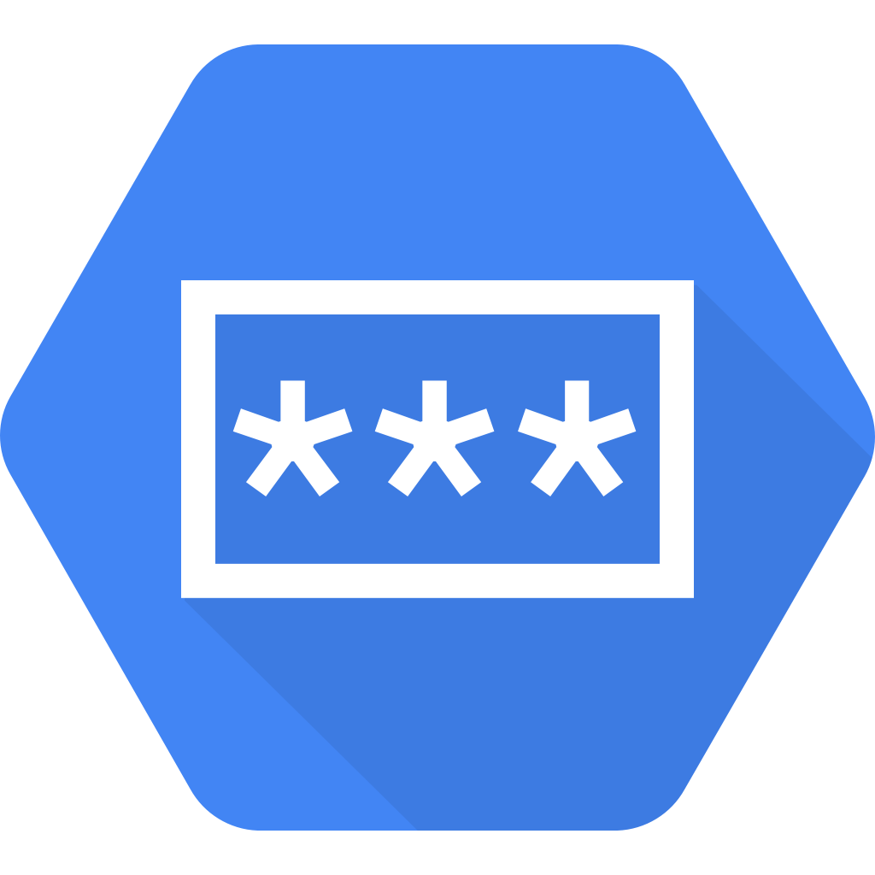
Zero-Trust IAM - Technical
Cloud Run – Scalable agent hosting
Vertex AI Search – RAG Policy Retrieval
A2A Isolation
Policy Intelligence
Cloud Storage – Compliance Policy docs
Privileged service beyond protocol boundary
Guardrails are applied automatically
Pub/Sub – Async event processing
Gmail API – Approval Communication
Firestore – Session & audit storage
Temporal Guards
Gemini 2.5 – NLU Classification
Active enforcement of time restrictions via conditional IAM bindings with JIT expiry
Cloud IAM – Policy Execution
Secret Manager – JWT Key
Notes:
The strength of the solution comes from three deliberate innovations.
First, A2A privilege isolation. The orchestrator cannot impersonate the provisioning agent and cannot write IAM. Even in a worst-case LLM misfire, privilege stays contained.
Second, policy intelligence via RAG. Instead of rewriting policy documents as code, the system extracts rules directly from existing PDFs and pages. No human interpretation needed. The guardrails are applied automatically and consistently.
Third, conditional IAM bindings with JIT expiry. Access is granted for exactly the required time window using CEL. The expiry is automatic. No cleanup scripts. No manual follow-ups. No leakage of privileges.
These three elements take IAM from reactive and error-prone to fast, predictable, and safe.

Slide 7
Business Impact
15 sec
Provisioning Time
Global IAM Market is projected to reach $34.3 billion by 2029, at a CAGR of 8.4% according to MarketsandMarkets November 2024 report.
IBM's Cost of a data breach report 2024 shows IAM-related breaches average $4.88 million in damages.
Regulators from India to China and Australia now effectively require strong IAM for banking, education and consumer data, pushing over 60-75% of enterprises to formalize identity governance.
Vs hours manually
9 steps
Automated Workflow
End-to-end orchestration
100%
Audit Coverage
Immutable trail
9 GCP
Services Integrated
Production-grade
Notes:
I pulled some stats to put into perspective the market research on this problem. As per these reports, The global IAM market is exploding no doubt. But the stakes are high too solidifying that the Zero Touch IAM Security solution has the advantage of fast provisioning essential for compliance and competitiveness.

Slide 8
Go-To-Market
Phase 1: Q1 2026
Phase 2: Q2-Q3 2026
Phase 3: Q4 2026
Production PAM System replacing JIT simulation to Provisioning agent.
Emergency Revocation Mechanism across active sessions.
Improve Resilience and High Availability – rate limiting, multi-region cloud run deployment and tighten error handling mechanism.
Orchestrator adaption to Google Cloud Agent Catalog including SSO
Multi-approver workflows with and/or logic.
Risk scoring engine using ML to flag anomalous access patterns.
Self-service policy editor for compliance teams.
Slack/ Teams integration for approval notifications.
Expanding approval responses to email replies with text.
Auto-revocation based on behavioral anomaly detection.
Policy drift detection with automatic remediation suggestions.
Integration with SIEM platforms.
Notes:
Zero-Touch IAM removes slow human bottlenecks. It removes privilege from anything LLM-driven. It removes inconsistent interpretation of policy. It removes mutable audit gaps. And it delivers a fast, controlled, secure IAM experience end to end. From a GTM standpoint, this aligns naturally with IAM modernization and Zero-Trust uplift programs. The architecture fits the Agent Catalog pattern. It scales across onboarding, offboarding, temporary privilege workflows, and access review cycles — all without putting privileged credentials behind an LLM.
Industries like finance, health, government, and resources can adopt this pattern immediately.
This is not a demo artefact. It’s a reusable enterprise architecture.

